Slide 1
Experiments
(samples)
0.1 | 0.8 | 0.3 | 0.4
2.2 | 0.2 | 0.9 | 0.8
1.2 | 0.1 | 0.8 | 0.7
0.3 | 0.9 | 0.2 | 0.3
0.2 | 0.5 | 0.3 | 0.5
0.4 | 0.7 | 0.3 | 0.2
Genes

Slide 2
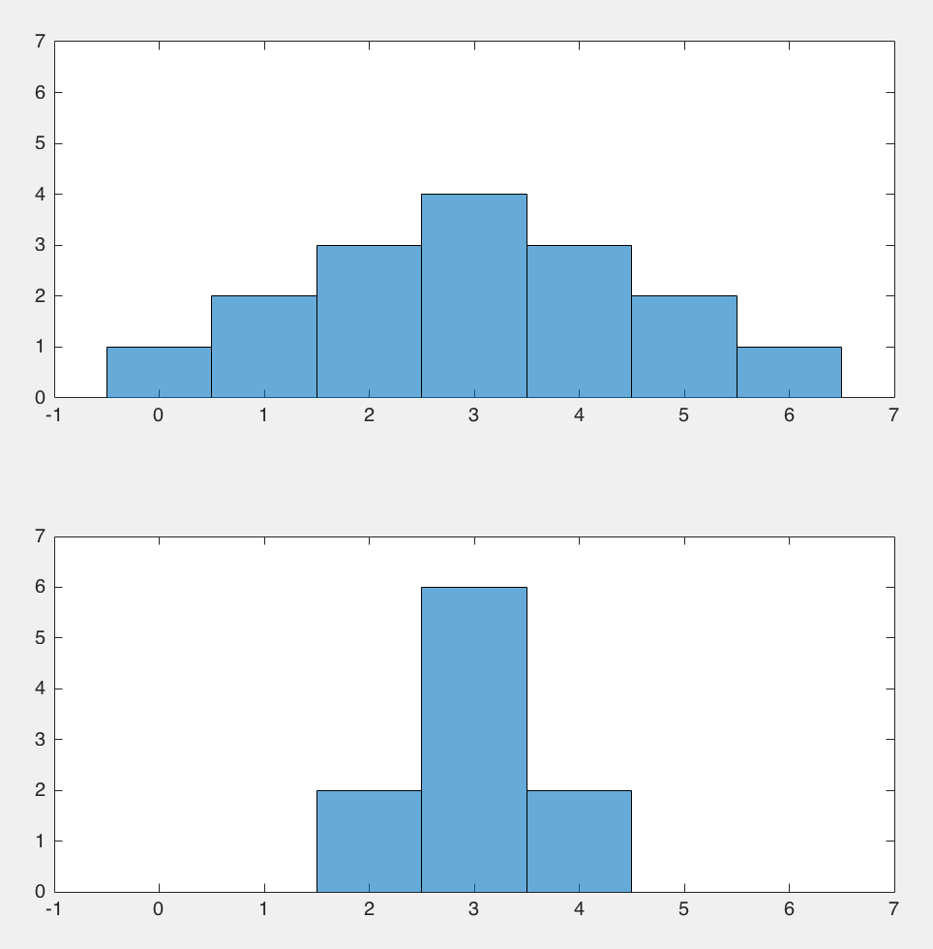
mean
variance
variance

Slide 3
Alternative coordinate systems

